Slide 1
Current Mapping Of CAM Elements in PAC
Pacio project

Slide 2
Acute Onset
Item ID | MDS: C1310A | LCDS: C1610A
Section Name: | Section C: Cognitive Patterns | Section C: Cognitive Patterns
Short Name: | CAM: Acute onset mental status change | CAM: Acute onset
Question Text: | Acute Onset Mental Status Change. Is there evidence of an acute change in mental status from the {patient's/resident's} baseline? | Is there evidence of an acute change in mental status from the {patient's/resident's} baseline?
Valid Response Values (Code, Text): | 0 No 1 Yes ^ Blank (skip pattern) - Not assessed/no information | 0 No 1 Yes ^ Blank (skip pattern) - Not assessed/no information
LOINC | 2.64 54632-5 | 2.63 85634-4

Slide 3
Inattention
Item ID | MDS: C1310B | LCDS: C1610C
Section Name: | Section C: Cognitive Patterns | Section C: Cognitive Patterns
Short Name: | CAM: Inattention | CAM: Inattention
Question Text: | Did the {patient/resident} have difficulty focusing attention, for example, being easily distractible or having difficulty keeping track of what was being said? | Did the {patient/resident} have difficulty focusing attention, for example, being easily distractible or having difficulty keeping track of what was being said?
Valid Response Values (Code, Text): | 0 Behavior not present 1 Behavior continuously present, does not fluctuate 2 Behavior present, fluctuates (comes and goes, changes in severity) ^ Blank (skip pattern) - Not assessed/no information | 0 No 1 Yes ^ Blank (skip pattern) - Not assessed/no information
LOINC | 2.64 54628-3 | 2.63 85634-4

Slide 4
Disorganized Thinking
Item ID | MDS: C1310C | LCDS: C1610D
Section Name: | Section C: Cognitive Patterns | Section C: Cognitive Patterns
Short Name: | CAM: Disorganized Thinking | CAM: Disorganized thinking
Question Text: | Disorganized Thinking - Was the {patient's/resident's} thinking disorganized or incoherent (rambling or irrelevant conversation, unclear or illogical flow of ideas, or unpredictable switching from subject to subject)? | Was the {patient's/resident's} thinking disorganized or incoherent, such as rambling or irrelevant conversation, unclear or illogical flow of ideas, or unpredictable, switching from subject to subject?
Valid Response Values (Code, Text): | 0 Behavior not present 1 Behavior continuously present, does not fluctuate 2 Behavior present, fluctuates (comes and goes, changes in severity) ^ Blank (skip pattern) - Not assessed/no information | 0 No 1 Yes ^ Blank (skip pattern) - Not assessed/no information
LOINC | 2.64 54629-1 | 2.63 85651-8

Slide 5
Altered Level of Consciousness
Item ID | MDS: C1310D | LCDS: C1610E2
Section Name: | Section C: Cognitive Patterns | Section C: Cognitive Patterns
Short Name: | CAM: Altered Level of Consciousness | CAM: Altered conscious level - vigilant/Lethargic/Stupor/Coma
Question Text: | Altered Level of Consciousness - Did the {patient/resident} have altered level of consciousness, as indicated by any of the following criteria? vigilant - startled easily to any sound or touch, lethargic - repeatedly dozed off when being asked questions, but responded to voice or touch, stuporous - very difficult to arouse and keep aroused for the interview, comatose - could not be aroused | Vigilant (hyperalert) or Lethargic (drowsy, easily aroused) or Stupor (difficulty to arouse) or Coma (unarousable)
Valid Response Values (Code, Text): | 0 Behavior not present 1 Behavior continuously present, does not fluctuate 2 Behavior present, fluctuates (comes and goes, changes in severity) ^ Blank (skip pattern) - Not assessed/no information | 0 No 1 Yes ^ Blank (skip pattern) - Not assessed/no information
LOINC | LOINC 2.64 54630-9 | 2.63 85655-9

Slide 6
Fluctuating Course
Item ID | LCDS: C1610B
Section Name: | Section C: Cognitive Patterns
Short Name: | CAM: Fluctuating course
Question Text: | Did the (abnormal) behavior fluctuate during the day, that is, tend to come and go or increase and decrease in severity?
Valid Response Values (Code, Text): | 0 No 1 Yes ^ Blank (skip pattern) - Not assessed/no information
LOINC | 2.63 85634-4

Slide 7
Altered conscious level - alert
Item ID | LCDS: C1610E1
Section Name: | Section C: Cognitive Patterns
Short Name: | CAM: Altered conscious level - alert
Question Text: | Alert (Normal)
Valid Response Values (Code, Text): | 0 No 1 Yes ^ Blank (skip pattern) - Not assessed/no information
LOINC | LOINC 2.63 85646-8

Slide 8
PROPOSED SPADES

Slide 9
Proposed SPADES (MDS, IRF, LTCH, OASIS)
Although multiple versions of the CAM have been developed, CMS is proposing that the Short version be adopted for standardized patient assessment data elements. The Short CAM contains only four items (i.e., items 1 to 4) from the original Confusion Assessment Method (Long CAM). These items focus on an acute change in mental status, inattention, disorganized thinking, and altered level of consciousness¹
The Short CAM data elements are currently collected in the MDS and the LCDS, and the scoring is based on staff observations of signs and symptoms of delirium. While the Short CAM data elements are used in both assessment tools, the response options currently differ. The current version of the LCDS includes two response options (yes/no, indicating that the behavior is present or not present), whereas the MDS offers three response options (behavior continuously present, does not fluctuate; behavior present, fluctuates; behavior not present). The LCDS and MDS versions of the CAM also differ slightly in wording and criteria for the “Altered Level of Consciousness” item¹
https://www.cms.gov/Medicare/Quality-Initiatives-Patient-Assessment-Instruments/IRF-Quality-Reporting/Downloads/Proposed-Specifications-for-IRF-QRP-Quality-Measures-and-SPADE.pdf

Slide 10
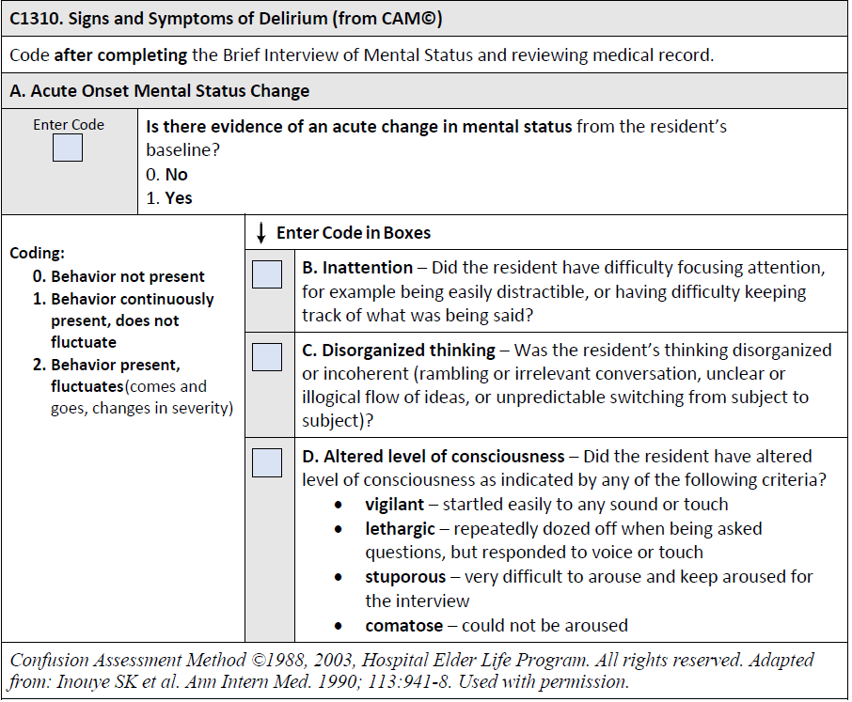
Proposed SPADE Mockup
https://www.cms.gov/Medicare/Quality-Initiatives-Patient-Assessment-Instruments/IRF-Quality-Reporting/Downloads/Proposed-Specifications-for-IRF-QRP-Quality-Measures-and-SPADE.pdf

Slide 11
CAM (Short versus Full)
CAM Items | CAM | Short CAM | CAM-ICU*
Acute Onset | x | x | x
Inattention | x | x | x
Disorganized thinking | x | x | x
Altered Level of Consciousness | x | x | x
Disorientation | x
Memory Impairment | x
Perceptual Disturbances | x
Psychomotor Agitation | x
Psychomotor Retardation | x
Altered Sleep-Wake Cycle | x
CAM:
https://www.mnhospitals.org/Portals/0/Documents/ptsafety/LEAPT%20Delirium/Confusion%20Assessment%20Method%20-%20CAM.pdf
Short CAM:
https://www.hospitalelderlifeprogram.org/uploads/disclaimers/Short_CAM_Instrument_8-29-2014.pdf
CAM- ICU:
https://www.aacn.org/docs/EventPlanning/WB0016/Delirium-CAM-ICU-gwgqydl2.pdf
*Contains ICU specific items such as sedation scores

Slide 12
Questions
What version of CAM should we be using?

